Slide 1
4.5 Keyloggers and Spywares

Slide 2
Key logging
It is a process of noting the keys struck on a keyboard in a covert manner
so that the person using the keyboard is unaware that such actions are being
monitored
Keylogger
It is a computer program that records every keystroke made by a
computer user especially in order to gain fraudulent access to passwords
and other confidential information
Quicker and easier way of capturing the passwords
Monitoring the victim’s IT savvy behaviour
They can be classified as
Software keylogger
Hardware keylogger

Slide 3
4.5.1. Software Keyloggers
They are software programs installed on the computer systems which usually are located between the OS and the keyboard hardware
Every keystroke is recorded
Installed by Trojans or viruses without the knowledge of user
Cybercriminals always install such tools on the insecure computer systems in public places(cybercafes,library) and can gain the required information about victim very easily
Consists of TWO files that get installed in the same directory
A DLL(Dynamic Link Library) file : does all the recording of the
keystrokes
EXE file that installs DLL file and triggers it to work

Slide 4
Examples of Software Keyloggers
www.softcentral.net SC-KeyLog PRO
Allows to secretly record user activities such as e-mails,chat conversations,visited websites
Captures Windows user logon passwords
Captured information is hidden from user
www.relytec.com AllvIn One Keylogger
Invisible keystoke recorder and a spy software tool
Secretly tracks all activities from user and automatically data is sent to a desired e-mail
One can read chat conversation,look ar e-mails,watch surfed sites

Slide 5
Examples of Software Keyloggers
www.blazingtools.com : Perfect Keylogger
Advanced keyword detection
Criminal can create a list of keywords/phrases
Keylogger will continuously monitor keyboard typing
When a keyword is detected by keylogger,it will send the screenshot through e-mail to criminal
www.kgb-spy-software.en.sofronic.com : KGB Spy
Multifunctional keyboard tracking software
Used by both regular and IT security specialists
Records keystrokes along with Language specific characters

Slide 6
Examples of Software Keyloggers
www.elite-keylogger.com : Elite Keylogger
Capture every keystroke,all passwords,chats,unstant messages,e-mails,websites visited,usernames,time of every activity
www.cyberspysoftware.com Cyber Spy
Keep track of employees are doing
Keep track of what children are doing
Can be used as complete PC monitoring solution at home/office records all websites visited,instant message conversations,passwords,e-mails,etc.
Ability to provide screenshots at set intervals

Slide 7
Examples of Software Keyloggers
www.mykeylogger.com : Powered Keylogger
Surveillance : To control what happens on computer when owner is away
Network administration : For network administrators to control outgoing traffic and sites visited
Shared PC activity tracking : To analyze the usage of shared PC
Parental control : Helps parents to monitor children’s computer and Internet activity
Employee productivity monitoring : To prevent leak of important information and to check productivity of the staff

Slide 8
4.5.2. Hardware Keyloggers
In these keyloggers,physical access to the computer system is required
They are small hardware devices connected to the PC and/or keyboard which save every keystroke into a file or in the memory of the hardware device
Installed on ATM machines or directly on the PCs
Look like they are integrated part of the system so customers are unaware of their presence
All hardware keylogger devices have to have the following:
A Microcontroller - this interprets the datastream between the keyboard
and computer, processes it, and passes it to the non-volatile memory
A non-volatile memory device, such as flash memory - this stores the
recorded data, retaining it even when power is lost

Slide 9
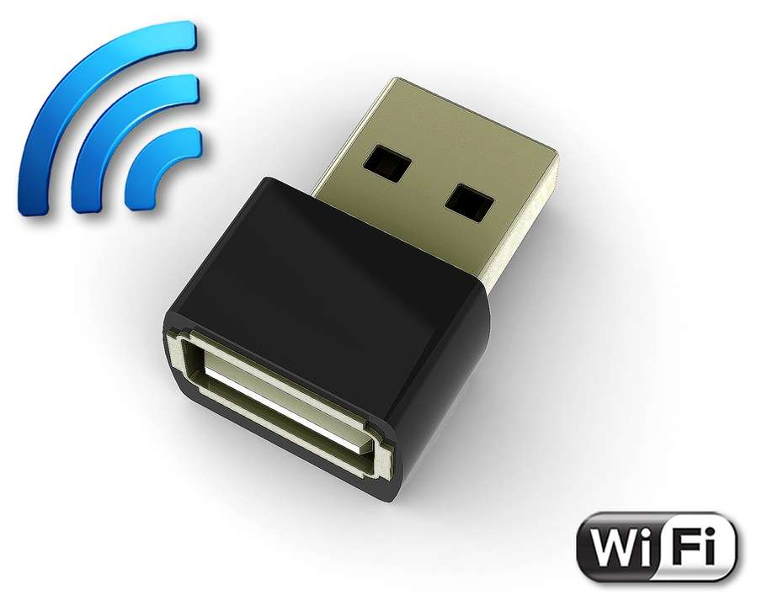
AirDrive Forensic Keylogger
It is an innovative ultra-small USB hardware keylogger, only 0.4" (10 mm) in length.
It can be accessed with any Wi-Fi device such as a computer, laptop, tablet, or smartphone.
It is the smallest hardware keylogger available on the market, making it a professional surveillance and security tool.

Slide 10
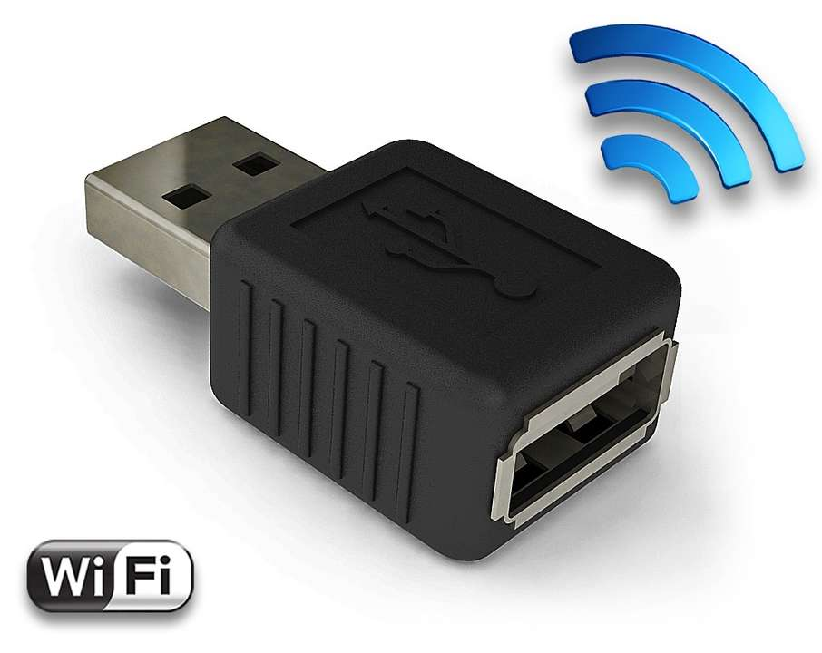
AirDrive Keylogger
It can be accessed with any Wi-Fi device such as a computer, laptop, tablet, or smartphone.
The Pro and Max versions offer time-stamping, E-mail reporting, data streaming, and up to 8 gigabytes of built-in memory.

Slide 11
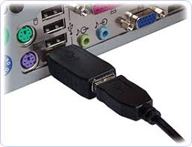
How they are used

Slide 12
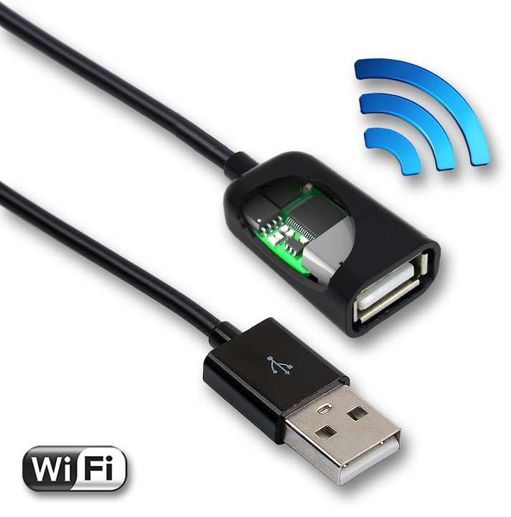
AirDrive Forensic Keylogger Cable
It is a series of specialized hardware keyloggers with Wi-Fi access, aiming at minimizing the risk of exposure.
They diverge from the classic USB adapter shape, making them nearly impossible to locate.
Available as a USB extension cable

Slide 13
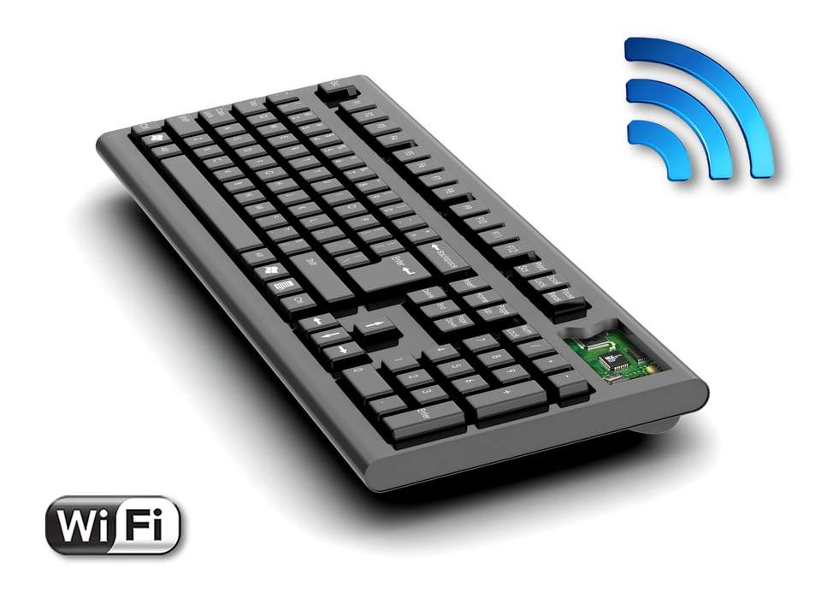
Forensic Keyboard
It is a customized keyboard with an integrated hardware keylogger.
The embedded hardware keylogger derives either from the KeyGrabber Forensic family, or from the AirDrive Forensic family.

Slide 14

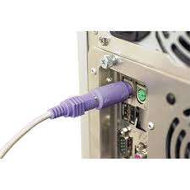
Forensic KeyGrabber

Slide 15
4.5.3. Antikeyloggers
It is a tool that can detect the keylogger installed on the computer system and also can remove it.
Advantages :
Firewalls can’t detect the installations of keyloggers on the systems but antikeyloggers can
Doesn’t need regular updates of signature bases to work and antispy programs effectively such as other antivirus
Prevents internet banking frauds as passwords can be easily gained by keyloggers
Prevents ID theft
Secures e-mail and instant messaging

Slide 16
4.5.5. Spywares
It is a type of malware that is installed on the computer which collects information about users without their knowledge
They are malicious softwares which are typically hidden from the user
Sometimes spywares such as Key loggers are installed by owner of a shared, corporate or public computer to secretly monitor other users
Features and functions :
Collect personal information about the victim such as Internet surfing habits/patterns,websites visited
Redirect Internet surfing activities by installing another utility on system
Ability to change computer settings leading to slowing of Internet connection and response time

Slide 17
Examples of Spywares
www.e-spy-software.com : 007 Spy
Capability of overriding antispy programs like “AD-AWARE”
Record all website URLs visited on internet
Powerful key logger to capture all passwords
View logs remotely from anywhere anytime
Password protection

Slide 18
Examples of Spywares
www.spectorsoft.com : Spector Pro
Captures all chats and instant messages
Captures emails (read, sent and received)
Captures websites visited
Captures activities performed on social websites
Enables to block any particular website and/ or chatting with anyone
Act as a key logger to capture every single key stroke

Slide 19
Examples of Spywares
www.remotespy.com : Remotespy
Remote computer monitoring without physical access
Key logging
Taking screenshots at regular intervals
Email account access
Chat conversation access
Record of websites visited

Slide 20
Examples of Spywares
www.flexispy.com : Flexispy
A tool that can be installed on mobile phones
Secretly records conversation happening on the phone and sends it to a specified email IDs

Slide 21
Examples of Spywares
www.pcphonehome.com : PCPhonehome
Tracks and locates lost or stolen laptops or desktop computers
Every time a computer system on which PCPhonehome has been installed connected to the internet, email is sent to specified email address of user’s choice and to PCPhonehome product company

Slide 22
Examples of Spywares
www.spyarsenal.com : SpyArsenal Print Monitor Pro
Keeps track on a printer usage
Records every document printed
Finds out who and when certain paper was printed with your hardware

Slide 23
Types of Spywares/ Malwares
Short form of malicious software
It is a software designed to inspect a system without owner’s informed consent
malware can be classified as follows:
Viruses and worms:
knows as infectious malware
spread form one computer to another with a particular behaviour
Trojan horses
Malware that appears to the user to perform desirable function but in fact facilitates unauthorized access to the user’s system

Slide 24
Types of Spywares/ Malwares
Backdoors:
It is a method of bypassing normal authentication, securing remote access to computer, obtaining access to plain text and so on while attempting to remain undetected
Rootkits:
Consists of one or more programs to obscure the fact that system has been compromised
Botnets: seen in chapter 2.
Keyloggers: seen in chapter 4.5
Spyware: seen in chapter 4.5

